Slide 1
Installing the Python Interpreter!
A simple guide

Slide 2
Contents
For Windows Devices
For Linux – Debian flavors

Slide 3
Installing Python
For windows

Slide 4
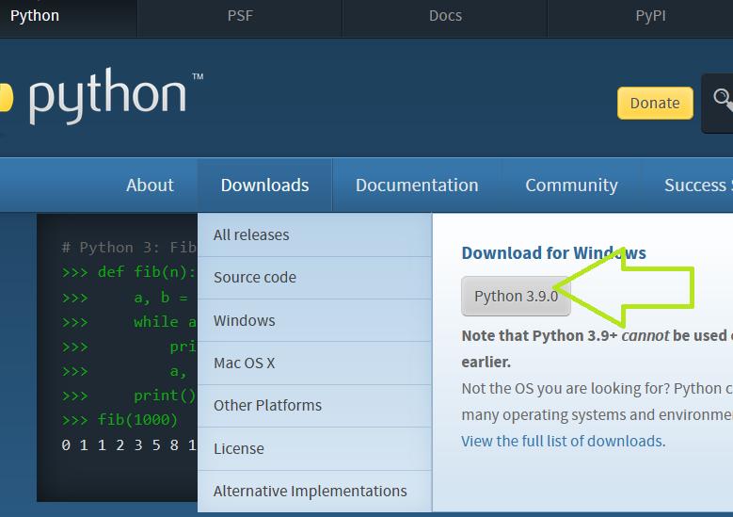
Step1
Go to https://www.python.org/downloads
Click on Download Python 3.X.x

Slide 5
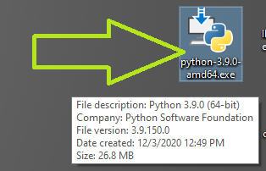
Step2
Once the installer’s finished downloading, go to the folder in your computer where you saved it, and double click it.

Slide 6
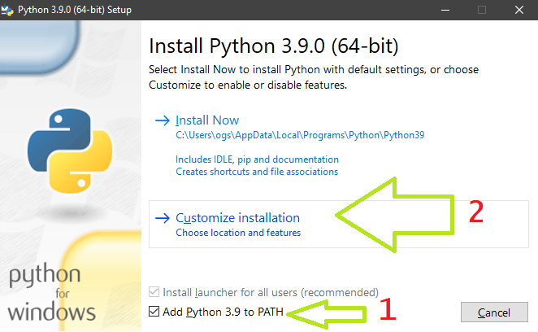
Step3
This screen appears
Be sure that Add Python 3.9 to PATH is checked.
Click on Customize installation

Slide 7
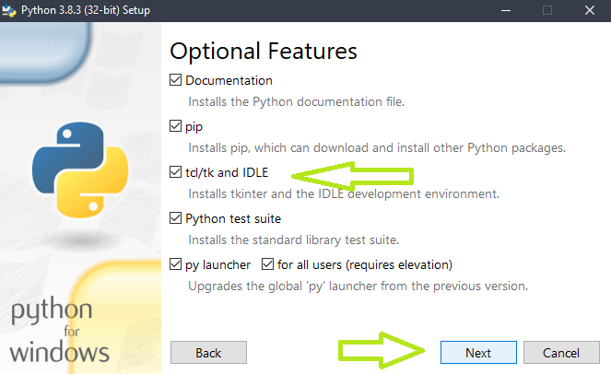
Step4
Be sure that the tcl/tk and IDLE option is checked.
Click on Next.

Slide 8
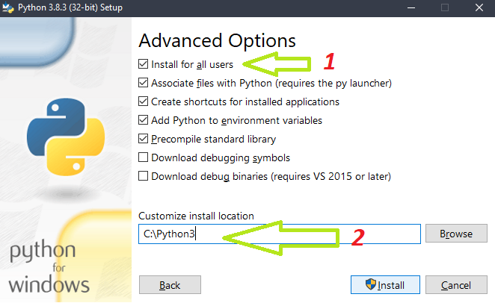
Step5
Check Install for all users.
Change the install location to: C:\Python3
Click on the Install button.

Slide 9
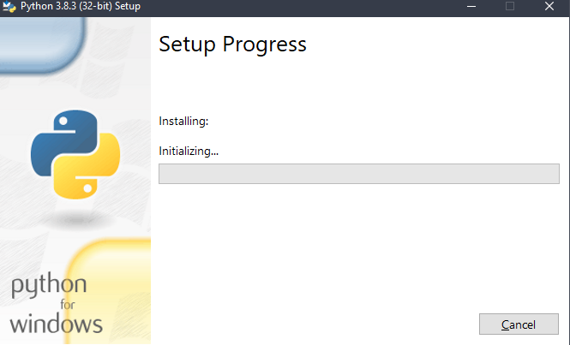
Step6
Please wait. This might take a while, depending on your machine’s on-board resources.

Slide 10
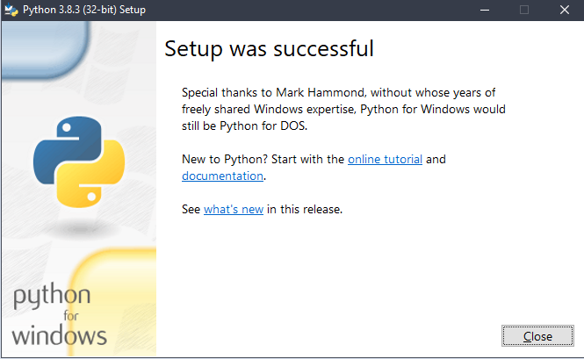
Step7
Once you see this screen, you have successfully installed Python3 on your computer!
Give yourself a pat on the back
Good Job!

Slide 11
Installing Python
For Linux

Slide 12
Step 1
Access your CLI terminal ctrl + alt + t
Update your distro!
sudo apt-get update –y
Install python3!
sudo apt-get install python3 –y
Once you’re done you can code on your desired text editor (i.e. Geany, VS Code for linux, etc), or just use VIM… or nano.
type python – to execute the interpreter mode.

